Slide 1
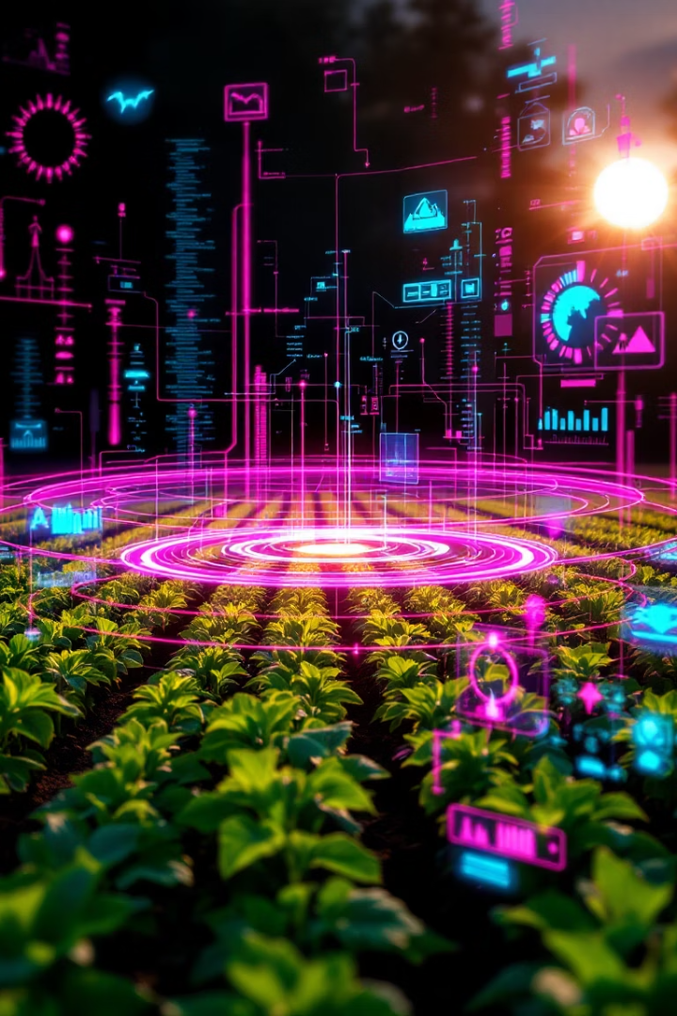
Krishi Sahayaak –AI Powered Agriculture Support System
Submitted By:- Sanchit Mishra e22cseu1183 Harsh Vardhan Chauhan e22cseu1188 Abhay Pratap e22cseu1174
Submitted to:- Dr. Sakshi Kalra, Dr. Rohit Kaliyar
This innovative system tackles key problems in modern agriculture through artificial intelligence.

Slide 2
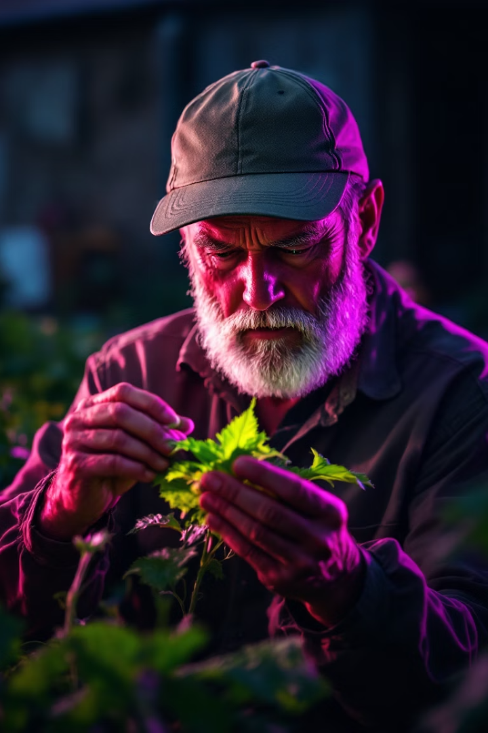



The Need: Precision Farming for Better Yield
Early Disease Detection
Traditional Limitations
Current diagnosis methods are slow and labor-intensive with limited rural access.
Detecting crop diseases early is vital for maintaining productivity and reducing losses.
Practical Solutions
Farmers need accessible technology for fast, reliable guidance in the field.

Slide 3






Project Overview: Dual AI Models for Farming
Integrated Solution
User-friendly web application for farmers
Disease Detection
CNN model analyzes leaf images
Crop Recommendation
ML model evaluates soil and climate data

Slide 4





CNN-Based Model: Crop Disease Detection
Image Input
Farmer uploads leaf photos
CNN Analysis
AI processes visual patterns
Diagnosis
Disease identified with 91% accuracy
Treatment
Recommended actions provided

Slide 5








ML-Based Model: Crop Recommendation
Rainfall Data
pH Level
Precipitation history and forecast
Soil acidity/alkalinity balance
Crop Recommendations
Nitrogen Content
Optimal crop selection with 99.5% accuracy
Soil fertility measurement

Slide 6

Seamless Integration: The Farmer-Friendly Web App
User Input
Farmers upload leaf images or enter soil data through simple forms.
Backend Processing
Python Flask routes data to appropriate AI models for analysis.
Results Delivery
Clear, actionable insights returned to user interface for immediate use.

Slide 7
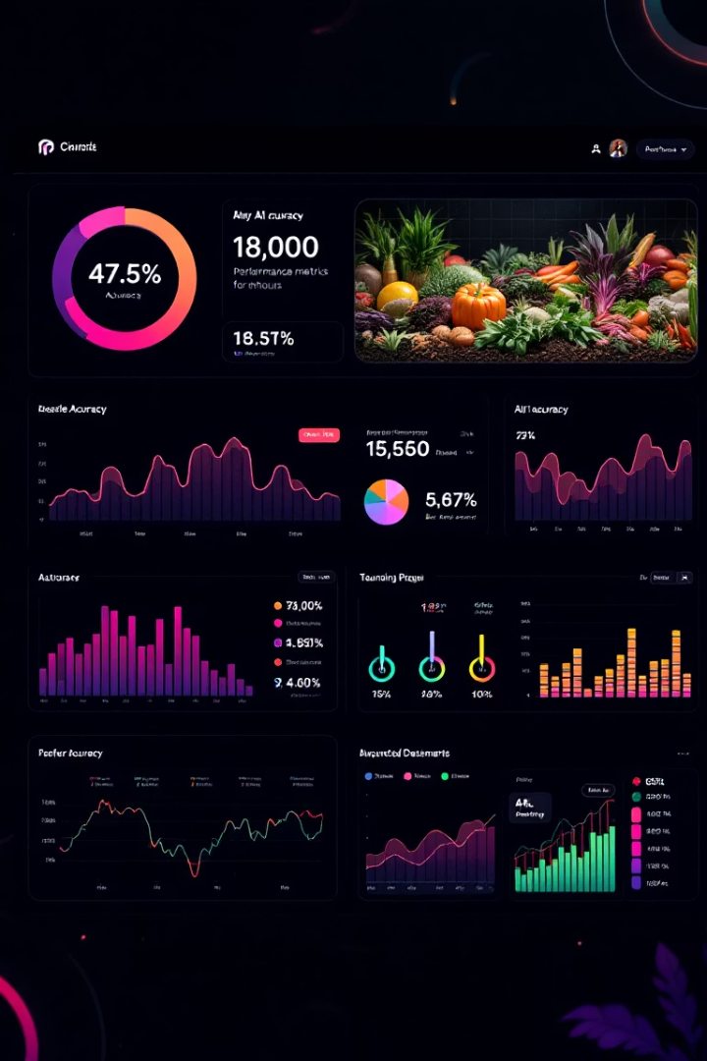
Results & Performance
91%
99.5%
Disease Detection
Crop Recommendation
Accuracy in identifying crop diseases from leaf images
Accuracy in suggesting optimal crops for conditions
2
AI Models
Integrated systems for comprehensive farm support

Slide 8

Conclusion & Future Directions
Current Impact
Future Expansion
AI models empower farmers with data-driven insights for higher yield and better crop choices.
Plans to expand disease detection to more crop varieties and integrate IoT sensor data.
Scalability
Solution designed for growth, supporting digital transformation across agricultural communities.

